Slide 1

CI/CD process implementation for basic application
Vlad Sanyuk
DevOps Crash Course 2021 by Oleksandr Lashchuk

Slide 2















Technologies
Basic application represented by WP on AWS RDS DB, phpmyadmin and Redis
IaC
Managed hosted k8s cluster
GitHub as SCM
Deployment method
CI/CD tool
Cluster management
Container registry
Code quality validation
Monitoring & Incident mgmt
Vlad Sanyuk
DevOps Crash Course 2021 by Oleksandr Lashchuk

Slide 3
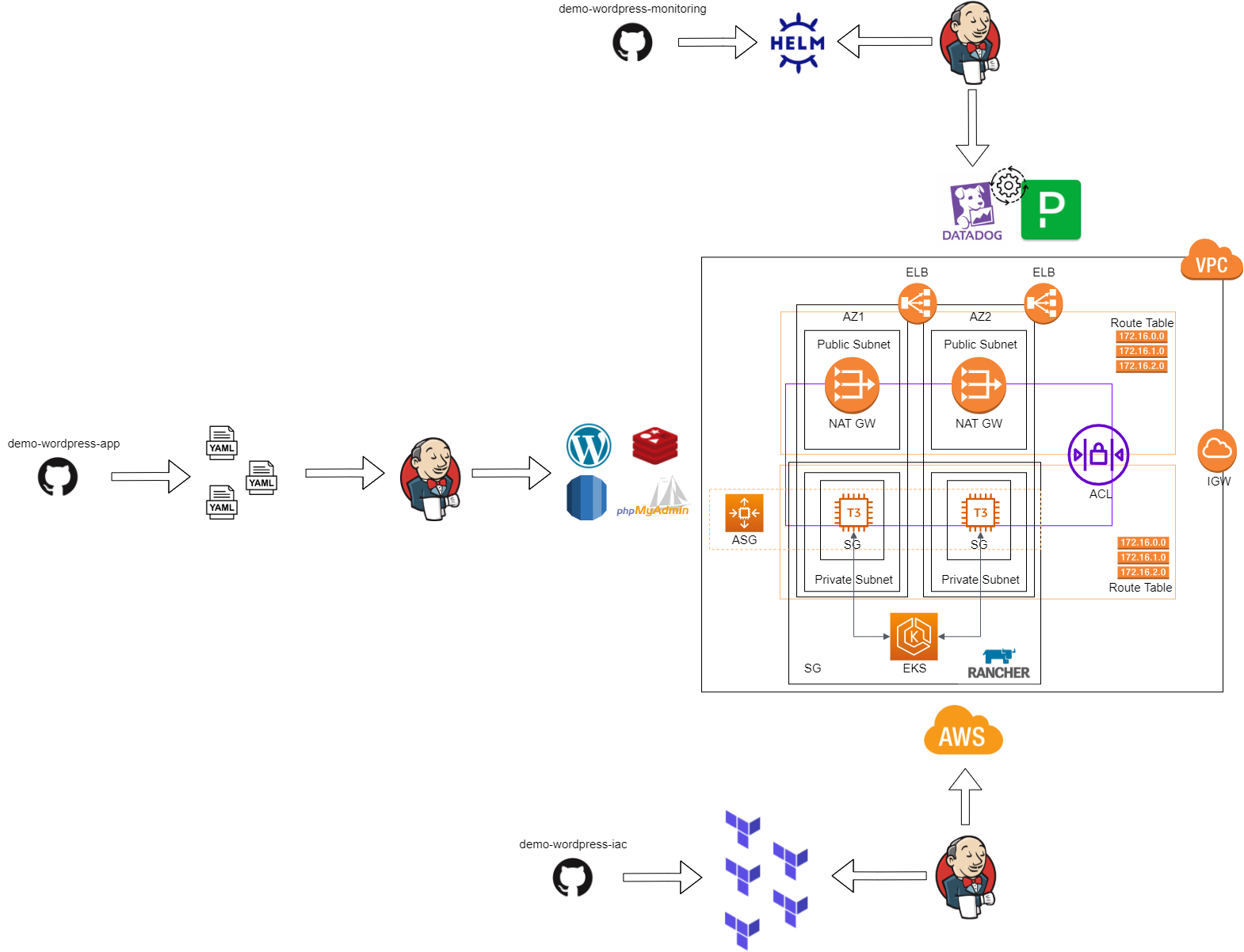
Architecture
Vlad Sanyuk
DevOps Crash Course 2021 by Oleksandr Lashchuk

Slide 4
Demo
Application
AWS resources
GitHub
Monitoring
Disaster Recovery & Self-Healing
Vlad Sanyuk
DevOps Crash Course 2021 by Oleksandr Lashchuk

